Slide 1

Remote control course2-Expand IR control
Yahboom
Yahboom OMIBOX Tutorial

Slide 2
1
2
3
4
5
Learning
goals
Download
code
Experimental
phenomena
Preparation
程序编程
About code
Tencent
Yahboom OMIBOX Tutorial

Slide 3
1
Preparation-1
1. The position of the Infrared receiver on the robot car
2. Learn how to use infrared remote control
Yahboom OMIBOX Tutorial

Slide 4


1
Preparation-2
As shown on the left figure above, the infrared receiver on the Omibox programmable robot circled by the red wire frame on the left.
As shown on the right figure above, infrared remote controller.
The infrared remote controller is used to send a signal to the infrared receiver, and the infrared receiver is used to receive the signal sent by the infrared remote controller.
Yahboom OMIBOX Tutorial

Slide 5
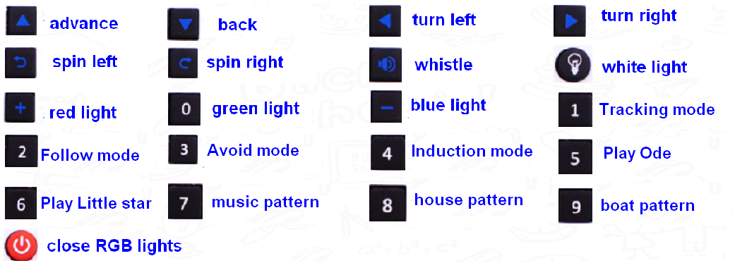
2
Learning goals
In this lesson, we mainly learn how to make the infrared remote controller to control the following functions of the Omibox programmable robot by programming.
Yahboom OMIBOX Tutorial

Slide 6
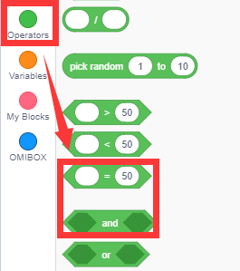
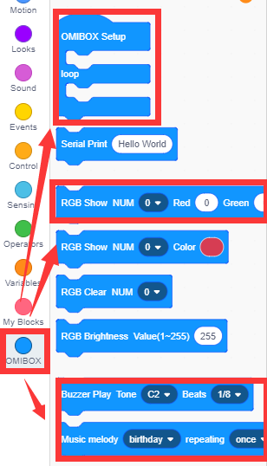
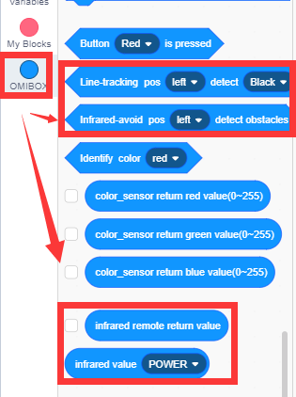
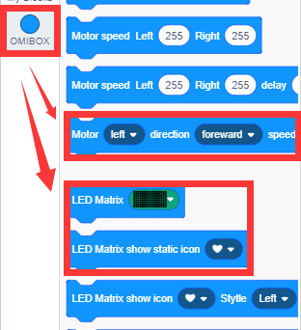
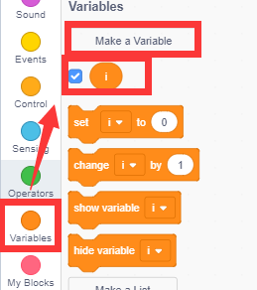
3
Search for blocks
The following is the location of the building blocks required for this programming.
Yahboom OMIBOX Tutorial

Slide 7
4
Combine blocks
Please see the Expand IR control.sb3 file for this experimental procedure.
Yahboom OMIBOX Tutorial

Slide 8
5
Experimental phenomena
After the program is uploaded, open the power of the car, the infrared remote controller corresponds to the following functions.
Yahboom OMIBOX Tutorial

Slide 9
Inspire Creativity Embrace Innovation
Thank you!!!
Yahboom

